Slide 1
Notes:
⚠️ [AUTOMATIC TRANSITION – DO NOT CLICK] ⚠️

Slide 2

General Information
Facial Recognition & Lock Device Demo
Temporary Visitor Authentication Demo
Introduction
Event Logging & Stranger Reporting Network Demo

Slide 3
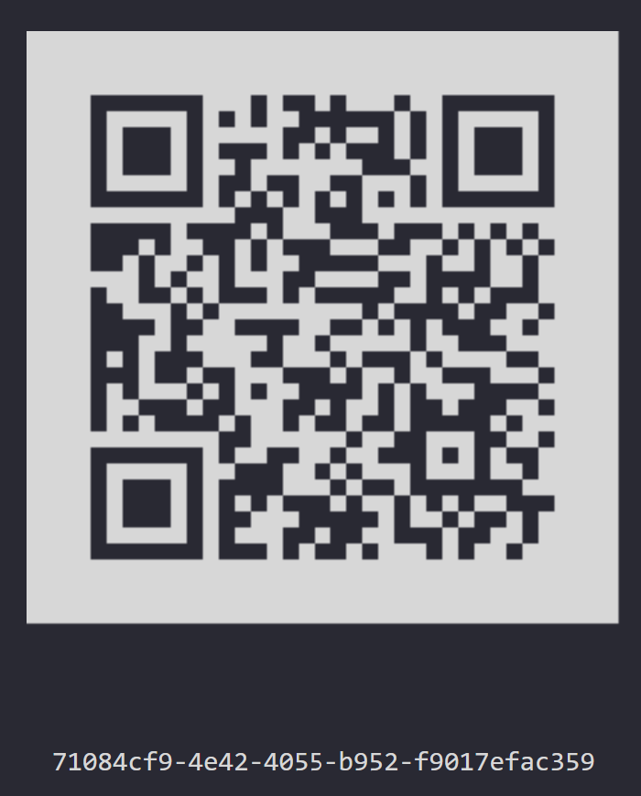
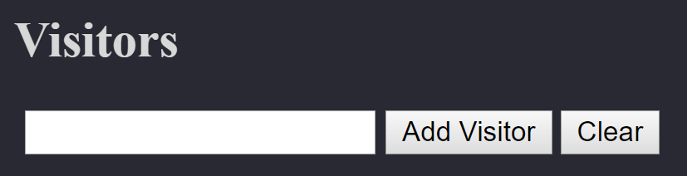

TEMPORARY VISITOR AUTHENTICATION

Slide 4

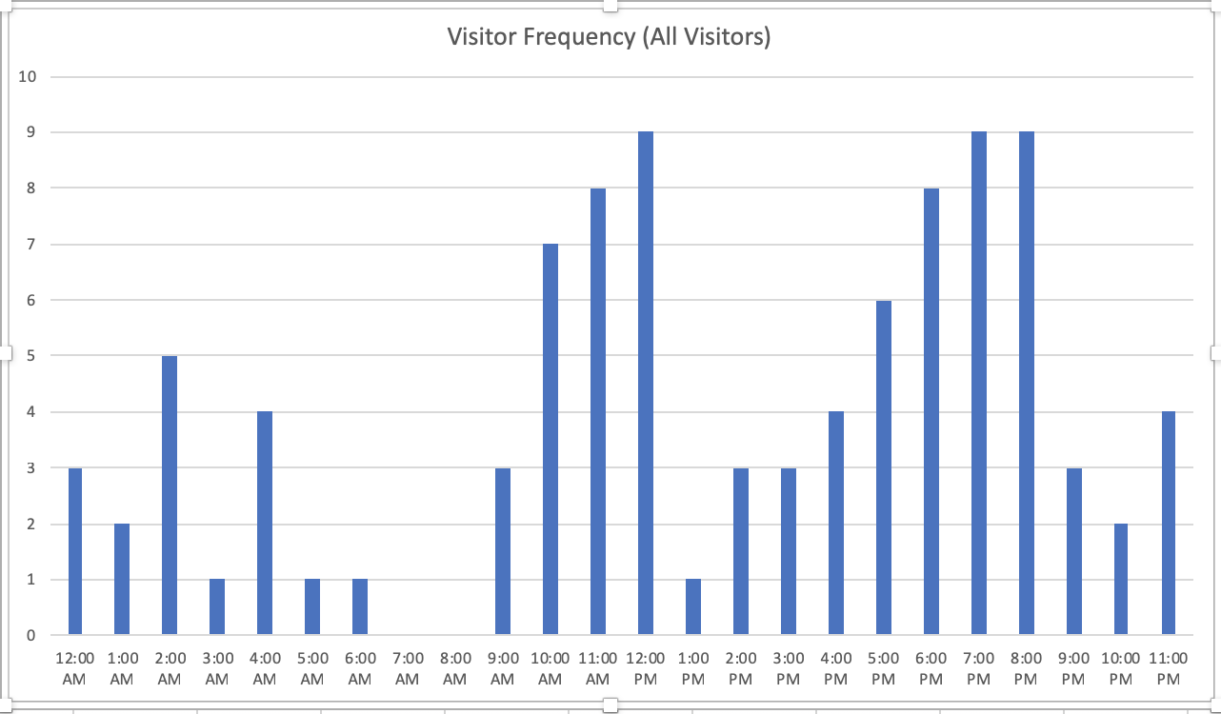
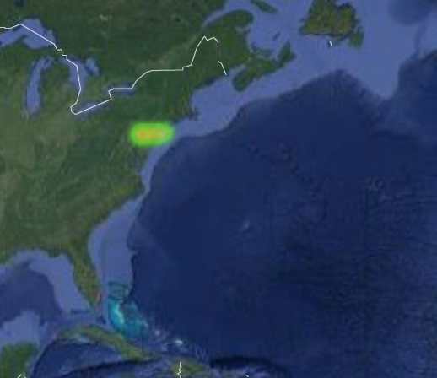


EVENT LOGGING, S.R.N., & DATA VISUALIZATION

Slide 5
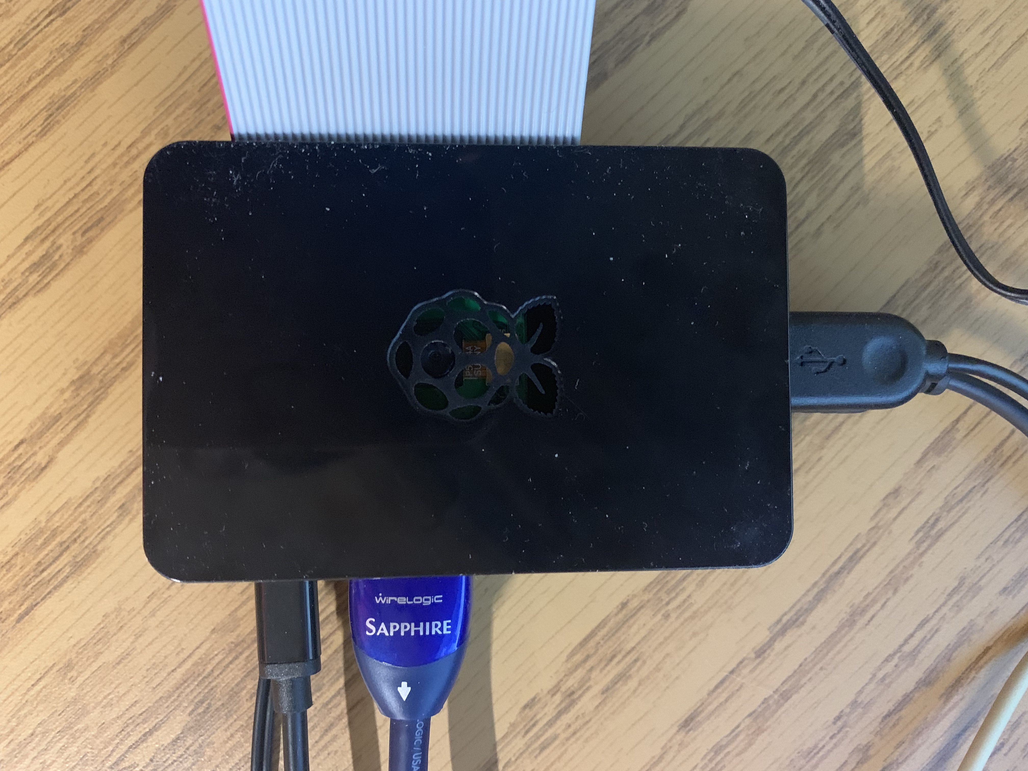
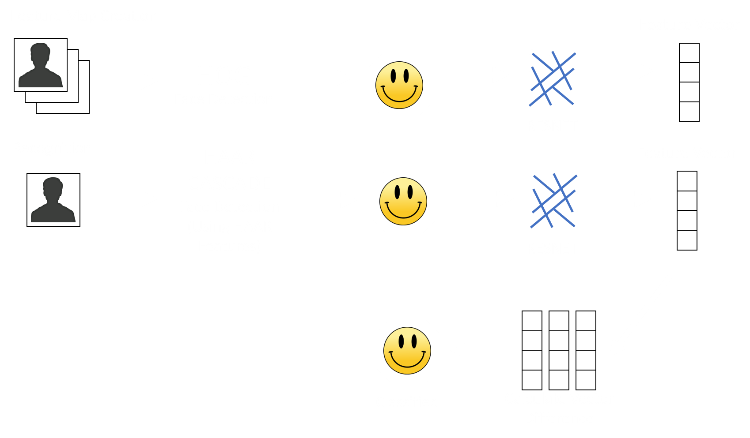
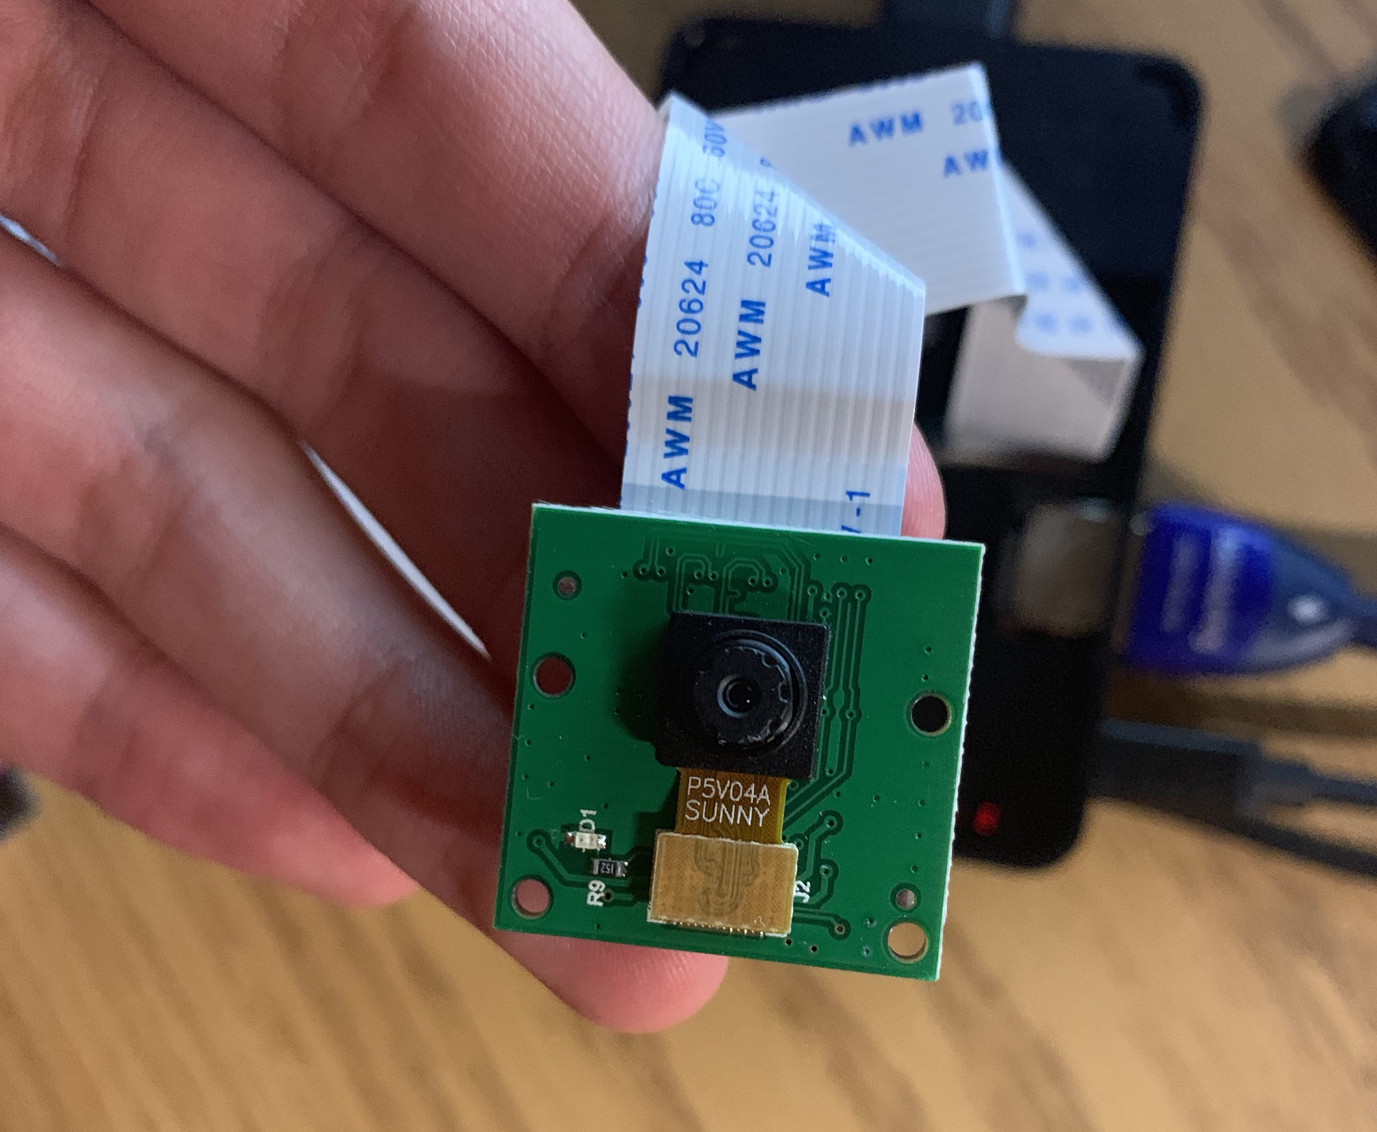
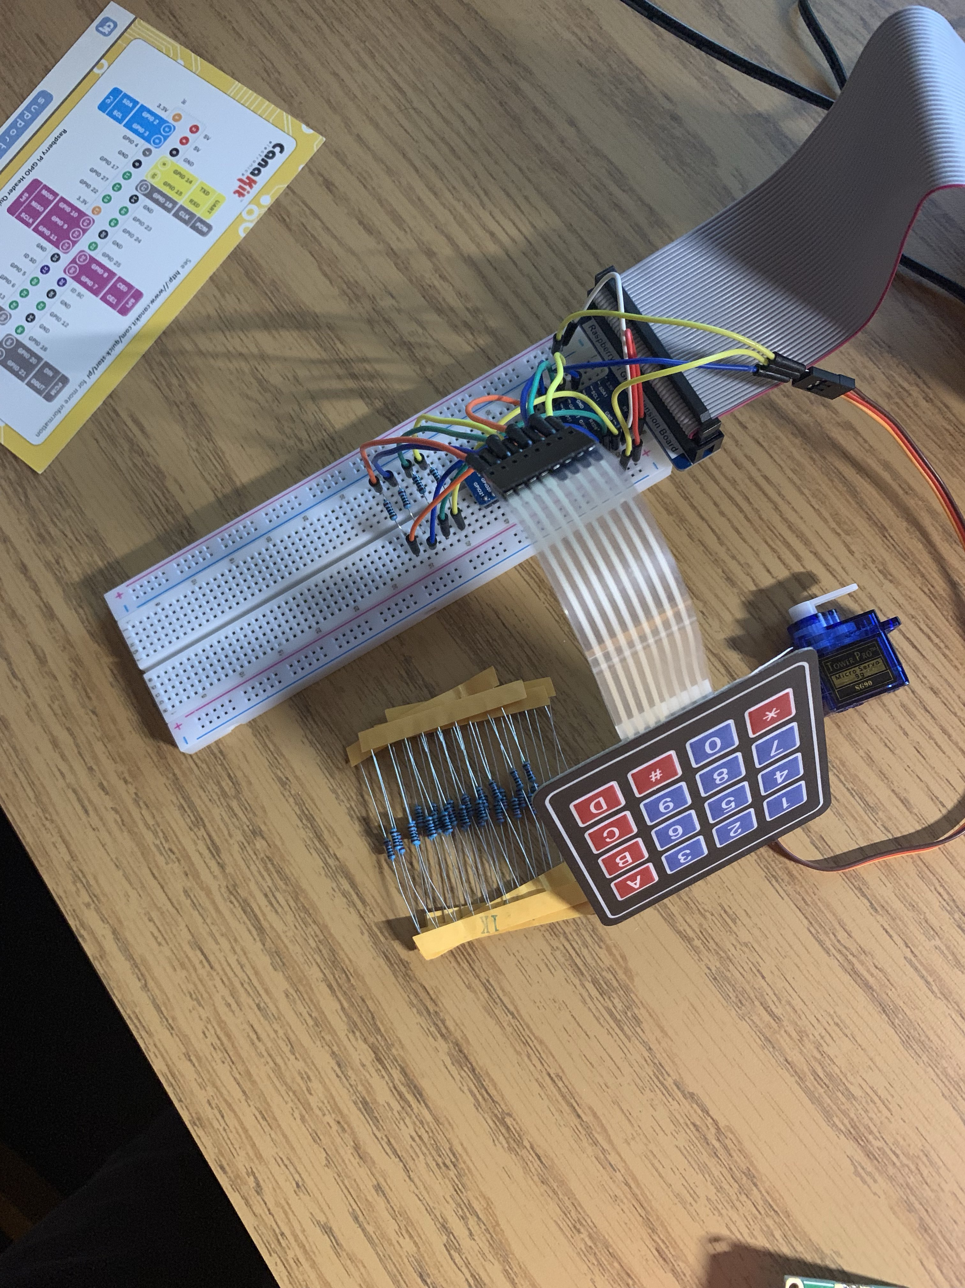
FACIAL RECOGNITION & LOCK DEVICE

Slide 6
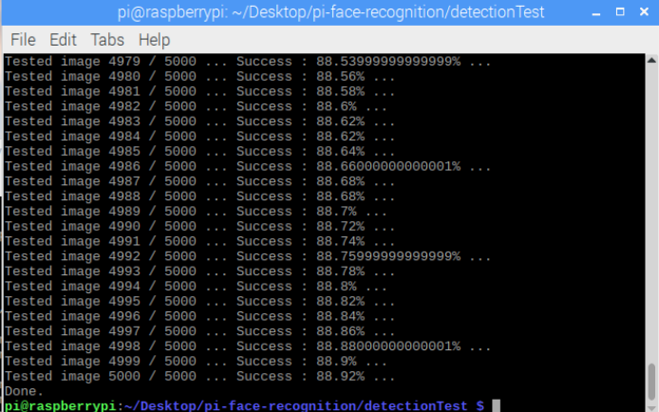
AUTOMATED TESTING OF DETECTION
Testing dataset courtesy of University of Maryland (umdfaces.io)

